Slide 1
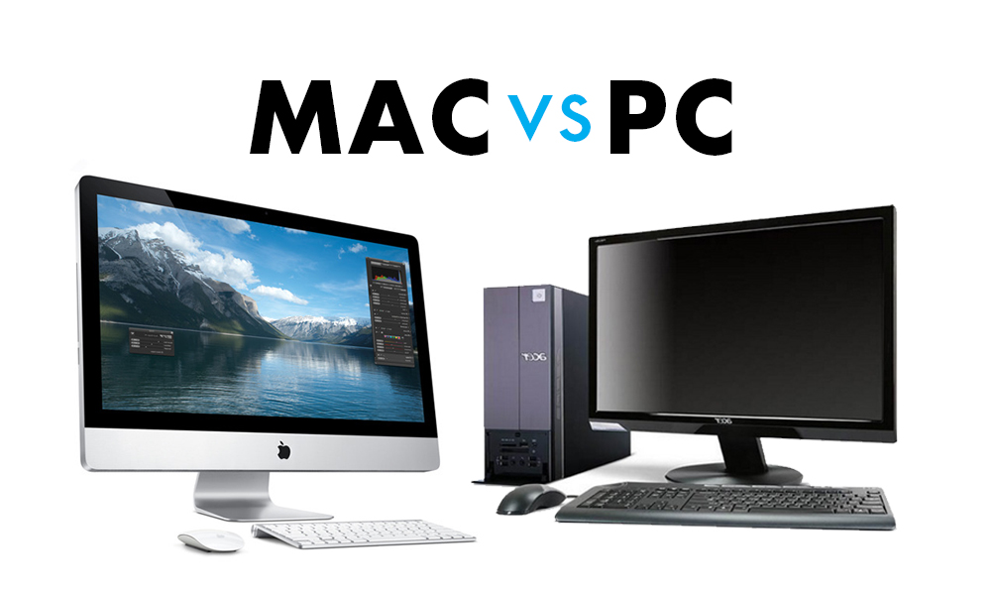
What we aren’t doing today:

Slide 2
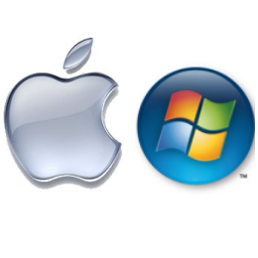
OSX vs Windows
(because accuracy is important)

Slide 3
What this isn’t:
Which is better?
OMG <insert OS here> looks so nice!!!1!!1!
Pretty much anything about interface

Slide 4
Hardware
“$1000 for the laptop, $1100 for a RAM upgrade, $1300 for the top processor, and $5000 for two Apple logos.”

Slide 5
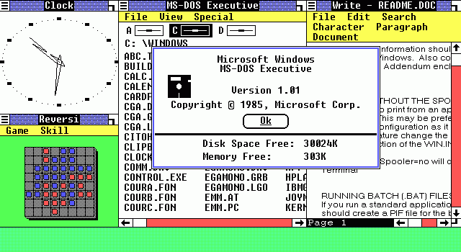
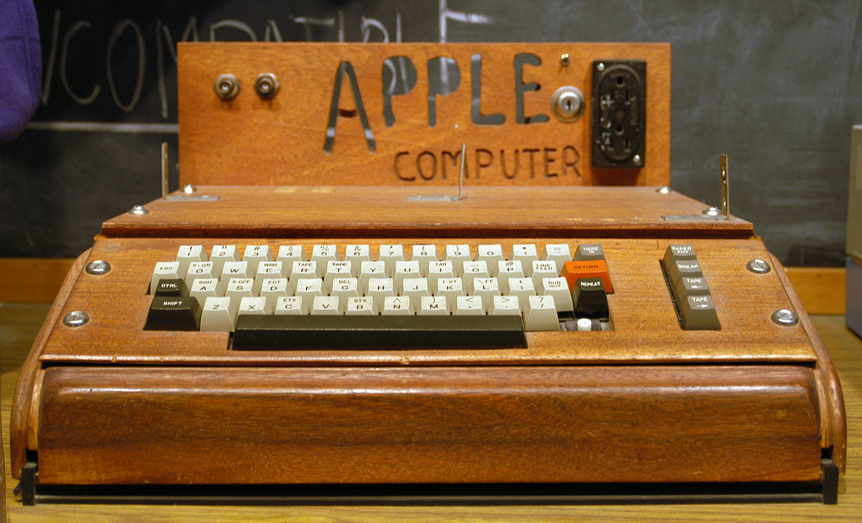
History intermission...

Slide 6
NTFS vs HFS+ (Filesystems)
Speed
Fragmentation
Space efficiency

Slide 7
Filesystems part 2
Basically they both suck. A lot.

Slide 8
DOS vs Unix
Note:
DOS != Windows
Unix != OSX
OSX is kinda a little close to Unix though, while Windows has moved quite far from its origins.
DOS = single-user
Unix = multi-user
Some DOS = password protected files
Unix = user/group/world permissions on files/folders
DOS = batch files
Unix = shell scripts

Slide 9
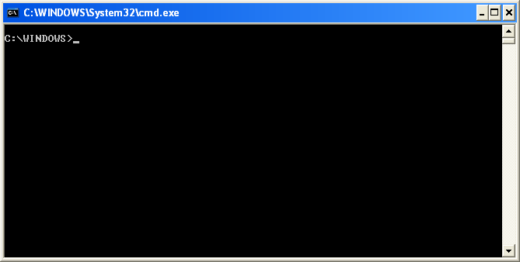
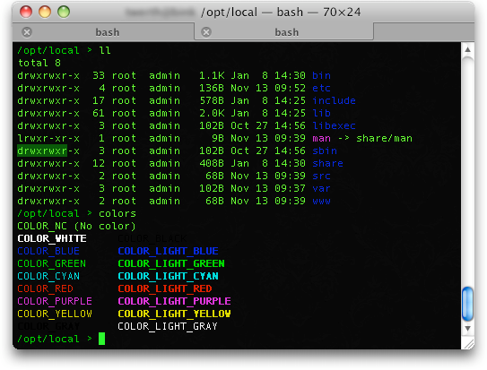
Command prompt vs terminal
… we don’t need to talk about this. Terminal isn’t exactly a great shell, but it’s a shell nonetheless..

Slide 10
What people usually argue about:
The interface. What it looks like. That’s not the OS.
Windows and OSX have tied the OS and the interface together, but they aren’t necessarily linked (i.e. Linux).

Slide 11
"An OS should never have been something that people (in general) really care about: it should be completely invisible and nobody should give a flying f*** about it except the technical people."
- Linus Torvalds

Slide 12
Fin!
Man, it’d be great if there were an OS that was awesome, and you could still choose and customize your interface…

